Slide 1
TRIAGE
ALISON ARMSTRONG RN BSCN ENC(C)
(CTAS)
Canadian Triage and Acuity Scale

Slide 2
WHAT IS TRIAGE?
“Triage” is the French word for “sort”. It is a process by which patients are prioritized and classified according to the type and urgency of their conditions.
Notes:
Assess and determine severity of presenting problems
Process patients into a triage category
Determine access to appropriate treatment
Effectively and efficiently assign appropriate human health resources
Source: NENA Position Statement A-1-4, 2002

Slide 3
THE ROLE OF THE TRIAGE NURSE
Assessing Patients
Communicating with the Public
Communicating with Health Professionals
Assigning Resources
Initiating Treatment Protocols
Monitoring and Reassessing
Participating in Patient Flow
Documenting
Notes:
What qualities does the triage nurse need to posess?

Slide 4
DOCUMENTATION
Date and Time
Patient Name
Age
Presenting Complaint
Subjective Assessment
Objective Assessment
Modifiers (1st order):
-Vital Signs
-Pain Scale
-Mechanism of Injury
Other Modifiers (2nd order)
CTAS Level
Medications
Immunization History
Relevant Past History
Triage Interventions
Disposition
Triage Nurse – ID
Reassessments
Notes:
First order modifiers are based on ABC, temp, pain, MOI
2nd order more specific-blood glucose, BP, bleeding disorders

Slide 5
THE PROCESS OF TRIAGE
Patient’s Arrival
Critical Look (ABCD) or (PAT)
Infection Control (FRI)
Subjective Assessment
Objective Assessment
The Triage Decision
Reassessments
Notes:
Component’s of PAT-general appearance, work of breathing, circulation

Slide 6
TRIAGE LEVELS / REASSESSMENT
Level | Time to RN Assessment | Time to Reassessment
Resuscitation- 1 | Immediate | Continuous
Emergent- 2 | Immediate | 15 Minutes
Urgent- 3 | 30 Minutes | 30 Minutes
Less Urgent- 4 | 60 Minutes | 60 Minutes
Non Urgent- 5 | 120 Minutes | 120 Minutes

Slide 7
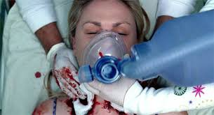
LEVEL 1/RESUSITATIVE
Conditions that are threats to life or limb (or imminent risk of deterioration) requiring aggressive interventions.

Slide 8
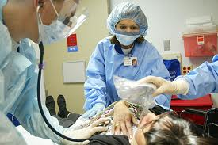
LEVEL 2/EMERGENT
Conditions that are a potential threat to life, limb or function, requiring rapid medical intervention by physician or medical directive.

Slide 9
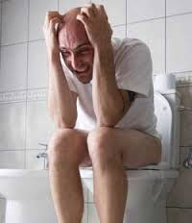
LEVEL 3/URGENT
Conditions that could potentially progress to a serious problem requiring emergency intervention. May be associated with significant discomfort or affect ability to function at work or in activities of daily living.

Slide 10
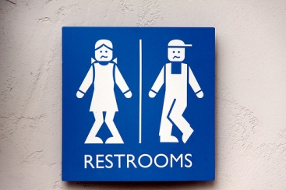
LEVEL 4/LESS URGENT
Conditions that relate to patient age, distress, or potential for deterioration that would benefit from intervention or reassurance within one or two hours.

Slide 11
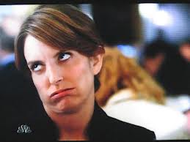
LEVEL 5/NON-URGENT
Conditions that may be acute but non-urgent as well as conditions which may be part of a chronic problem with or without evidence of deterioration. The investigation or interventions for some of these illnesses or injuries could be delayed or even referred to other areas of the hospital or health care system.

Slide 12
WHAT TRIAGE CODE IS IT?
Chest pain with ischemic features
fever >38.0 that looks unwell
headache-sudden, severe, worst ever
depression/suicide with plan
SOB moderate distress with O2 sats 92-94%
Abdominal pain-severe 8-10/10
altered LOC (GCS 10-13)
Level 2 - Emergent

Slide 13
WHAT TRIAGE CODE IS IT?
Diarrhea-mild, no dehydration
minor bites
dressing change
medication request
laceration/puncture not requiring sutures
Level 5 – Non Urgent

Slide 14
WHAT TRIAGE CODE IS IT?
Cardiac arrest
actively seizing
respiratory arrest
severe respiratory distress
altered level of consciousness (GCS 3-9)
Level 1 - Resuscitative

Slide 15
WHAT TRIAGE CODE IS IT?
Hypertension SBP>220 or DBP>130 with no symptoms
seizure-resolved with normal level of alertness
active labour
SOB mild resp distress
abdo pain moderate (4-7/10)
chest pain non cardiac features.
Level 3 - Urgent

Slide 16
WHAT TRIAGE CODE IS IT?
UTI complaints/symptoms
laceration requiring sutures
confusion-chronic
vaginal bleeding minor spotting.
Level 4 – Less Urgent

Slide 17
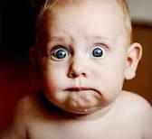
QUESTIONS?
Notes:
Get out your sample triage notes and here are the cases. Please complete the triage note and assign a code to the best of your ability. We will take up these cases in 30 mins.
Go through the triage form from top to bottom
explain the importance of filling it out completely.

Slide 18
Case Scenarios
Notes:
Trauma-2
Adult- 5
Paeds-3

Slide 19
CASE STUDY 1
A car pulls up to the doors of VH at 0130 today.
Two men carry another into the department shouting that he has been shot in the chest—the third man is covered in blood, his eyes are closed appears unconscious.
What is his triage code and what do you do?
Notes:
Trauma record

Slide 20
CASE STUDY 2
A 14-year male named Joe Blow states that he has run out of his asthma medication. His family is new to London and has no family doctor. VS: BP: 108\70 HR 66 RR 18 temp: 37.0
No resp distress
Allergies: seasonal
Meds: Pulmicort, Ventolin
PHM: asthma
Notes:
Paeds record

Slide 21
CASE STUDY 3
MLEMS patch reports they are on route with a 18 year old male from MVC.
Pt was a restrained back- seat passenger.
The pt. is tachycardic, c/o chest pain
PMH: none
Allergies: none, Meds: none
VS: HR-120, BP 100/50, O2 sat 96%, RR 24
Notes:
Trauma record

Slide 22
CASE STUDY 4
80-year-old female presents to the ED, complaining of pain and inability to move her left elbow. The pt states that 30 mins earlier she fell and tried to break her fall with her left arm. She denies any LOC or other pain. The pt is tearful and anxious bracing her left arm. The elbow has an obvious deformity with a large hematoma and swelling. The right radial pulse is strong whereas the left is weak. There is normal ROM in the left wrist and fingers but unable to move the left elbow.
VS: BP 110/60 Temp 37.0 HR 90(irreg) RR 24
Meds: see list Allergies: PCN
PMH: osteoporosis, a-fib, MI x 2, CABG

Slide 23
CASE STUDY 5
MLEMS patch @ 0330 – en route with a 2 y.o. boy with a cough and difficulty breathing
No allergies; cold symptoms began 24 hours ago
On examination, you note:
  Increased work of breathing
  Tracheal tug
  Retractions
  Frequent barky cough
  Inspiratory stridor
VS: HR-130, RR-40, O₂ sat-95%, BP-90/65, T-38.3
Paramedics gave nebulized ventolin X 2 en route to hospital

Slide 24
CASE STUDY 6
MLEMS arrives with a 35 year old collared and boarded patient.
They report this patient fell down 4 stairs.
He is alert and oriented. No LOC.
Complaining only of left knee pain, 4\10.
VS: 120\80 HR 88 RR 18 Temp 36.7
PMH: none,
Meds: none, Allergies: none

Slide 25
HOW WELL CAN YOU PRIORITIZE?
The following patients present to your ED with lower abdominal pain accompanied by other symptoms.
As triage nurse which would you rank as most emergent? (A,B,C or D?)
And what is their triage score?
What is their potential diagnosis?
Where do you want to send them in the department?

Slide 26
PATIENT A:
an 80 year old female with a history of diverticulitis. The left lower quadrant (LLQ) pain that is typical of her condition got worse today but then subsided. Now she has a `board-like` abdomen with generalized abd. Pain.
Vital Signs:
  Temp. 38C, BP 120\80, HR 112, RR 22.
  Allergy to morphine
  Meds:ASA, imodium, atenolol, levothyroxine

Slide 27
PATIENT B:
a 45-year-old male with sharp intermittent LLQ abdominal pain and back pain. He doesn’t have pain right now, but when it returns he cannot get a comfortable spot. His urine has visible blood in it.
Vital Signs:
  Temp 37.2C, BP 130\70, HR 78, RR 18
  Seasonal allergies
  Took ibuprofen at home

Slide 28
PATIENT C:
an 17 year old female has crampy periumbilical pain that has been slowly moving toward the right lower quadrant (RLQ) over the past two hours. She rates her pain as 3 out of 10 on the pain scale. She vomited once. Her pregnancy test is negative (Home test).
She walks with a slight limp. LNMP:3 weeks ago
Vital Signs:
  Temp 37.5C, BP 112\74, HR 100, RR 22.
  NKA
  Meds-BCP

Slide 29
PATIENT D:
a 52 year old male who complains of having some lower abdominal and scrotal pain that has gradually worsened in the last two days. He describes a burning sensation when he urinates.
Vital Signs:
  Temp 38C, BP 110\70, HR 80, RR 16.
  Allergy to PCN
  Hx-Hep C +
  Meds-lactulose, methadone

